Slide 1
ZnSnO₃–ECOFLEX/LDH–PU BASED TRIBOELECTRIC NANOGENERATOR
FOR MOTION-ACTIVATED BATTERY-FREE SMART STREET LIGHTING
COMSOL Files

Slide 2
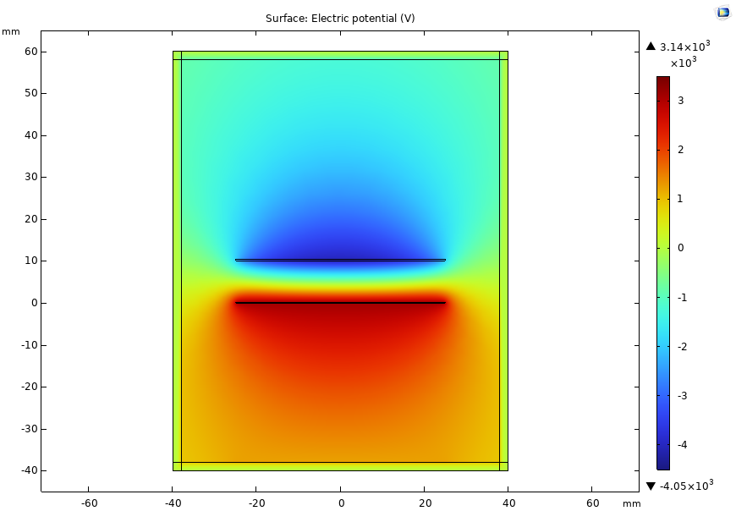
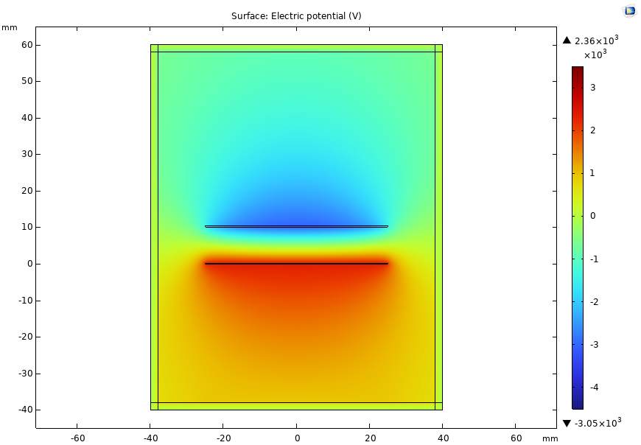
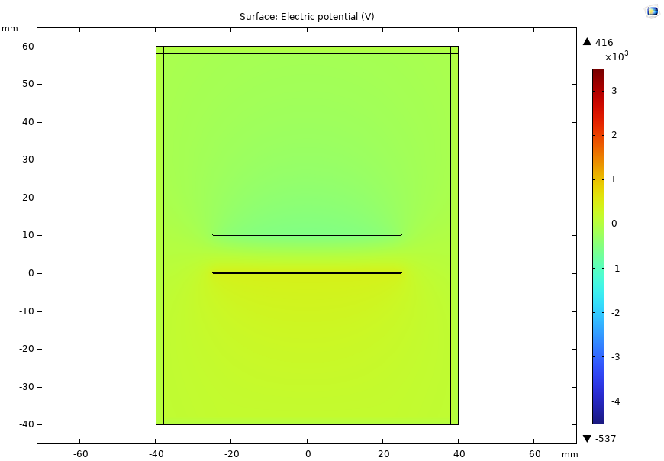
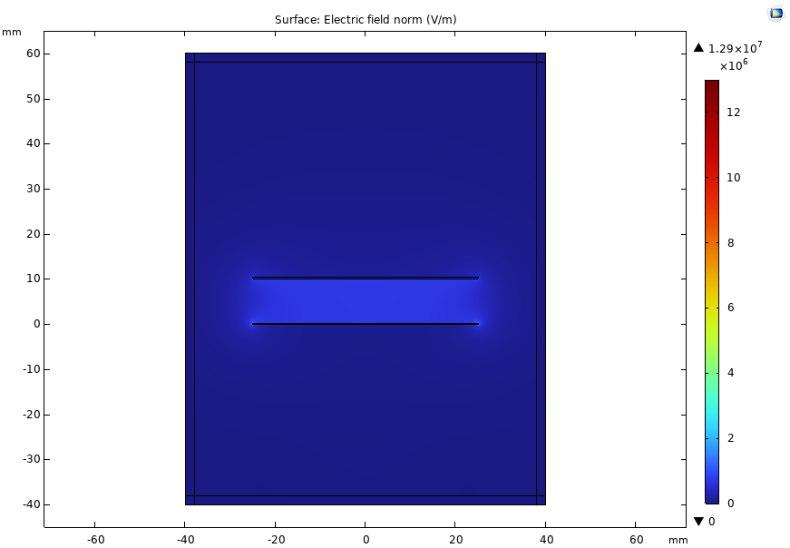

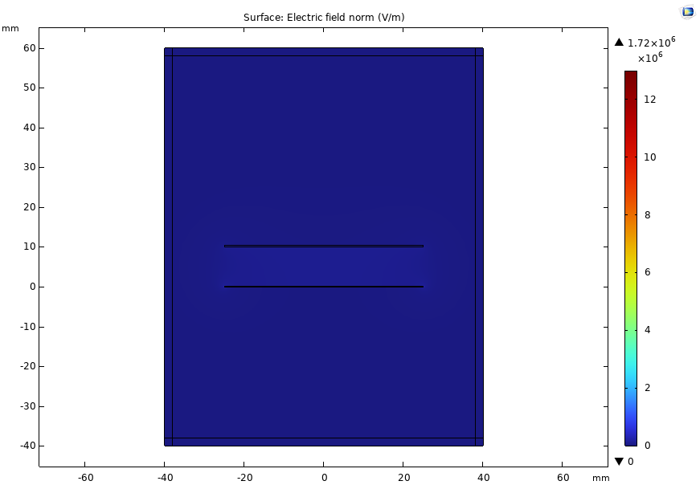
EZ1 PL5_10 mm
EZ1 PL0_10 mm
EZ0 PL0_10 mm
Parameter
* EZ1
- thickness: 0.25 mm
- Relative permittivity: 2.45
- Surface charge density: -7.54e-6 C/mn²
* PL5
- thickness: 0.08mm
- Relative permittivity: 2.4
- Surface charge density: 7.54e-6 C/mn²
* Al
- Thickness: 0.01mm
Parameter
* EZ1
- thickness: 0.25 mm
- Relative permittivity: 2.45
- Surface charge density: -5.68e-6 C/mn²
* PL0
- thickness: 0.08mm
- Relative permittivity: 2.1
- Surface charge density: 5.68e-6 C/mn²
* Al
- Thickness: 0.01mm
Parameter
* EZ0
- thickness: 0.25 mm
- Relative permittivity: 1.75
- Surface charge density: -1e-6 C/mn²
* PL0
- thickness: 0.08mm
- Relative permittivity: 2.1
- Surface charge density: 1e-6 C/mn²
* Al
- Thickness: 0.01mm

Slide 3
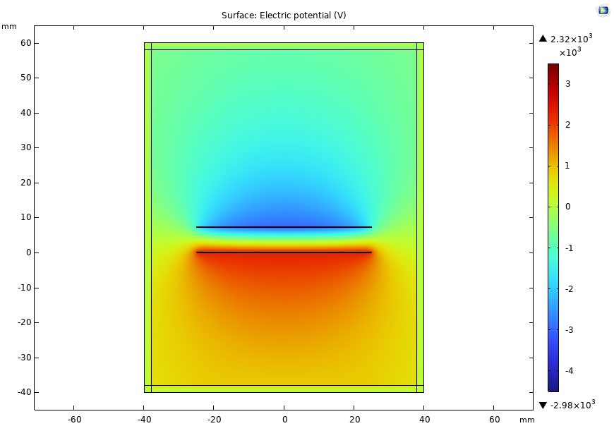
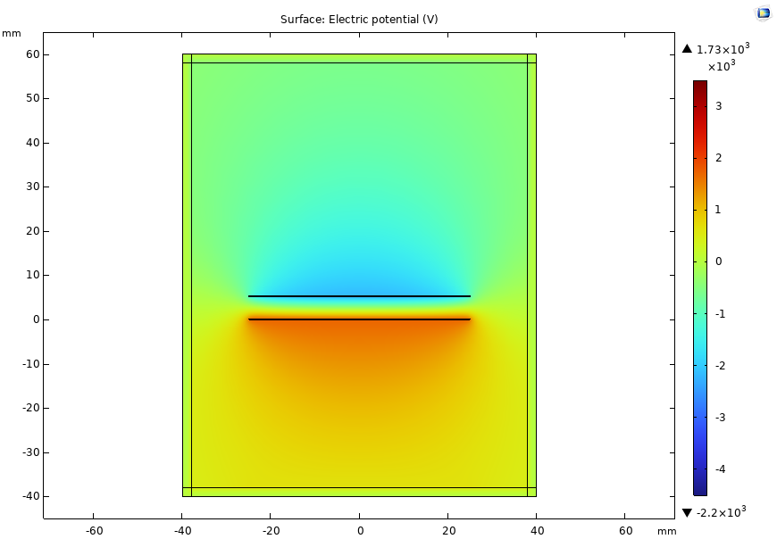
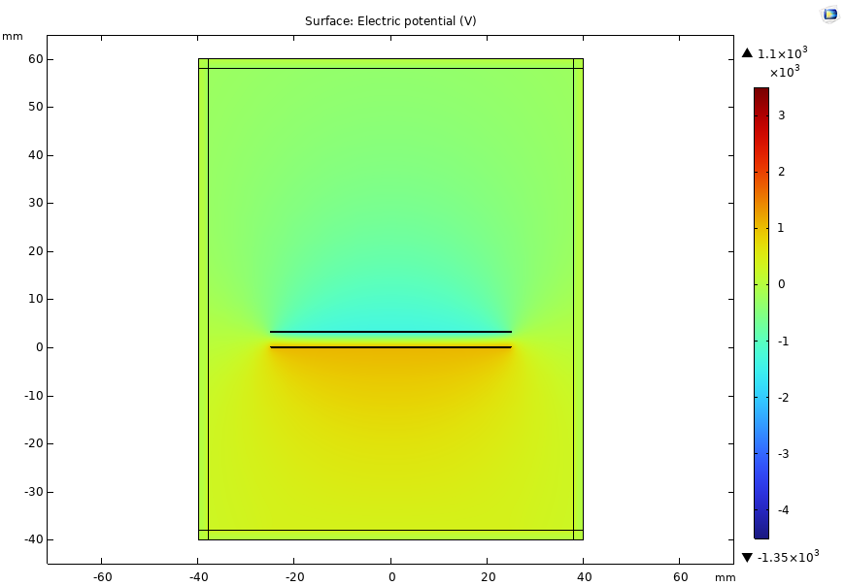
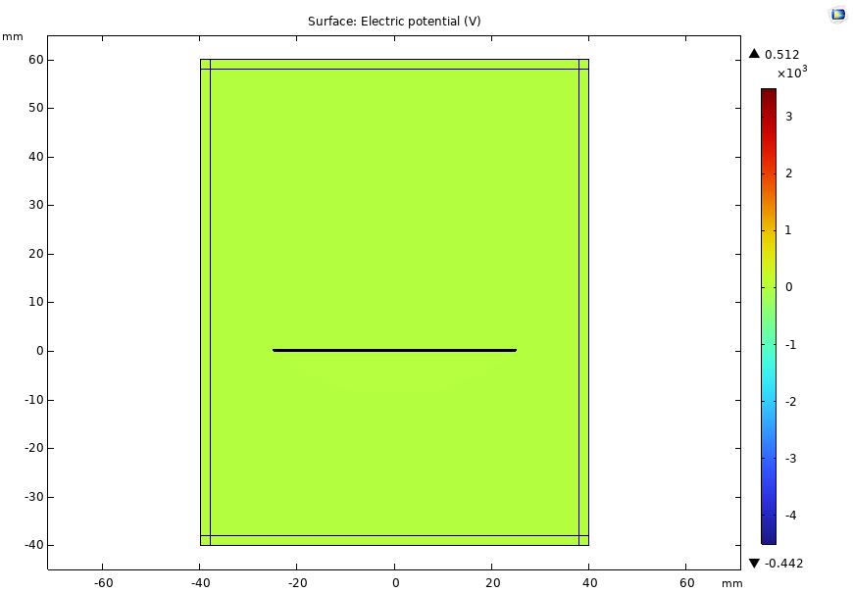

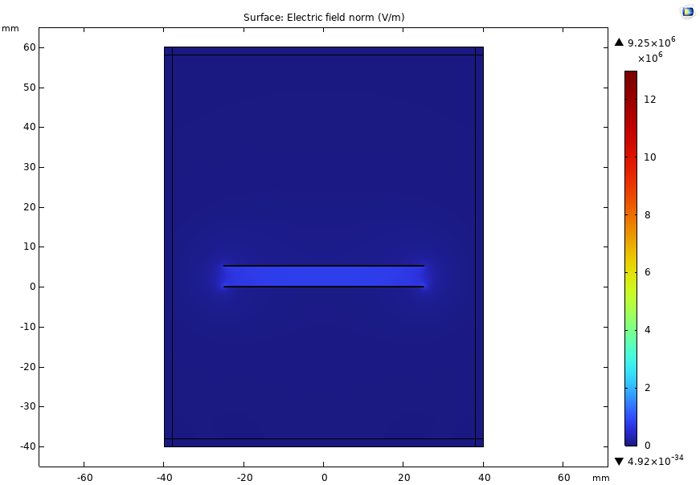
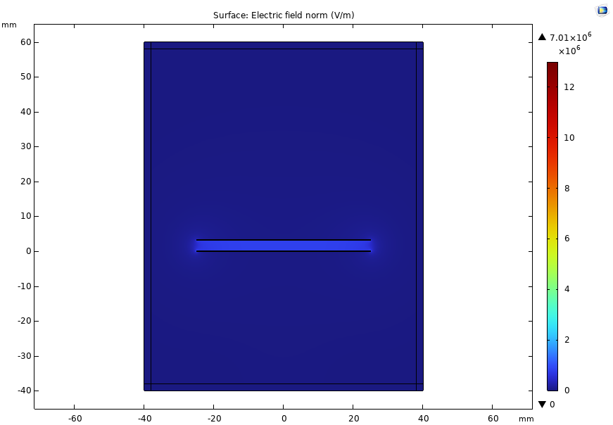
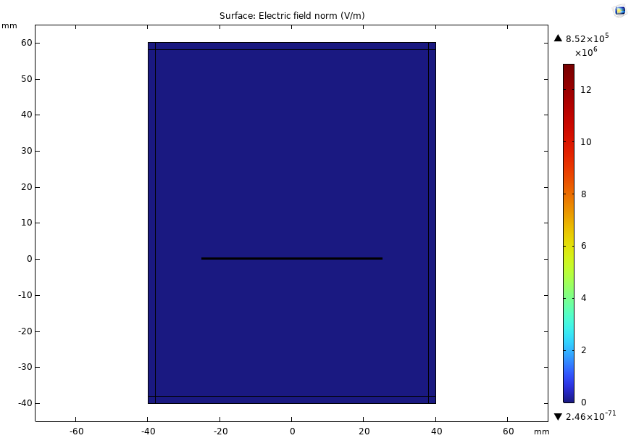
EZ1 PL5_10 mm
EZ1 PL5_7 mm
EZ1 PL5_5 mm
EZ1 PL5_3 mm
EZ1 PL5_0.001 mm

